Slide 1

Neural Networks and Neural Language Models
정보통신공학과 이승호

Slide 2

Units
The XOR problem
Feed-Forward Neural Networks
Training Neural Nets
Neural Language Models
INDEX

Slide 3

1. Units

Slide 4

Input, weight, bias, activation
The building block of a neural network – single computational unit
a set of real valued numbers as input $x_{1},x_{2},x_{3}, …,x_{n}$
Set of corresponding weights$w_{1},w_{2},w_{3}, …,w_{n}$
Bias $b_{}$
So weighted sum z can be represent
$z=b+ \sum_{i}{w_{i}x_{i}}$
To express this weighted sum using vector notation
$z_{}=w∙x+b$
Neural units apply a non-linear function $f_{}$ to $z_{} −activation$
$y_{}=a=f(z)$

Slide 5
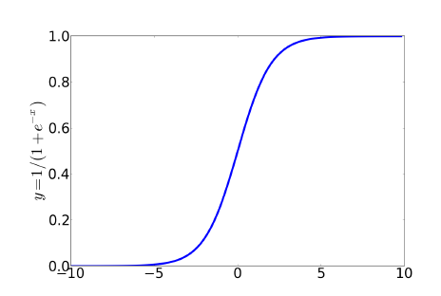
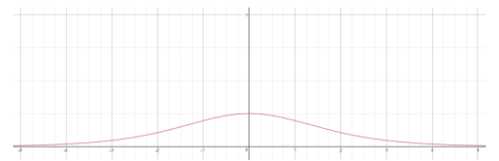
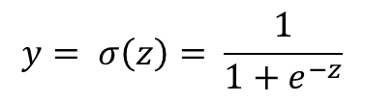
Sigmoid
$$y= σ\left(z\right)= \frac{1}{1+e^{−z}}$$
Maps the output into the range [0,1] –useful in squashing outliers
But
Gradient vanishing
Complexable Computation

Slide 6
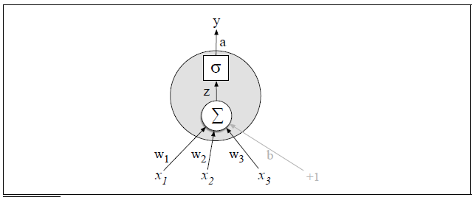

Example
$$x=\left[0.5, 0.6, 0,1\right]$$
$$w=\left[0.2, 0.3, 0,9\right]$$
$$b=0.5$$
$$y= σ\left(w∙x+b\right)=\frac{1}{1+e^{−(w∙x+b)}}=\frac{1}{1+e^{−(.5∗.2+.6∗.3+.9∗.1+.5)}}=e^{−0.87}=.70$$

Slide 7
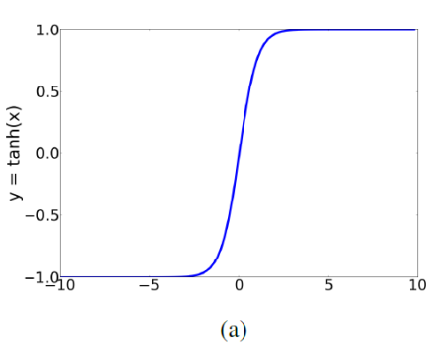
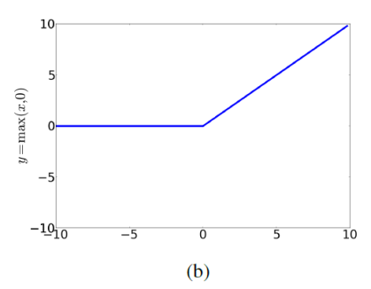

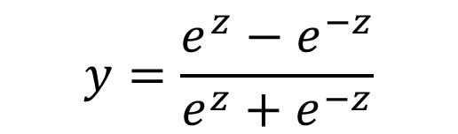
Tanh ReLU
$$y=\frac{e^{z}−e^{−z}}{e^{z}+e^{−z}}$$
$$y=max⁡(x,0)$$

Slide 8
2. The XOR problem

Slide 9
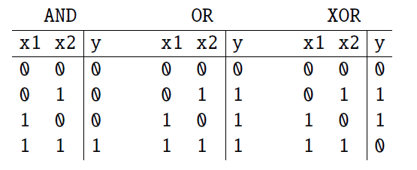
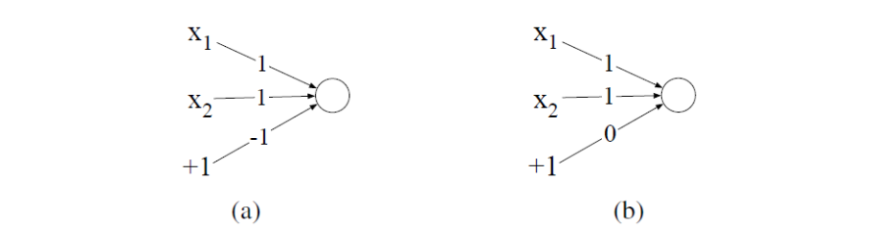
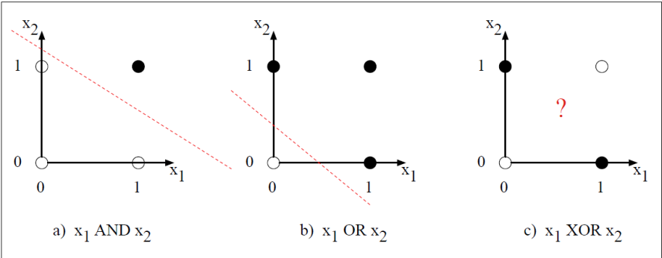
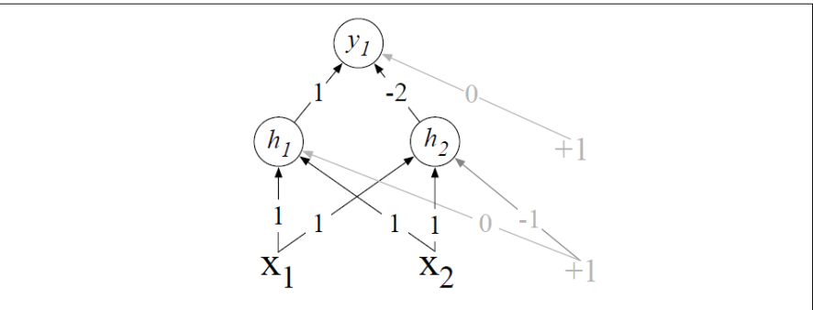
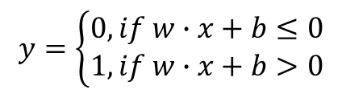
Minsky and Papert
Computing logical functions of two inputs
- AND, OR, and XOR
$$y=\left\{\begin{aligned}0, if w∙x+b≤0 \\ 1, if w∙x+b>0\end{aligned}\right.$$
Layered network of units using ReLU
input=[0,0]
h = [0,0]
Y = 0
input=[1,0]
h = [1,0]
Y = 1
input=[1,0]
h = [0,0]
Y = 0
input=[1,1]
h = [1,0]
Y = 1
Neural networks can automatically learn useful representations of the input

Slide 10
3.Feed-Forward Neural Networks

Slide 11
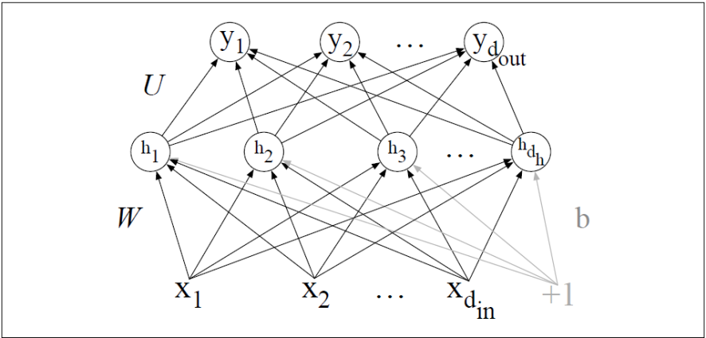
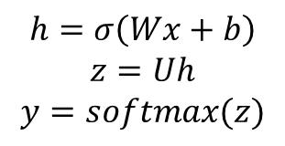
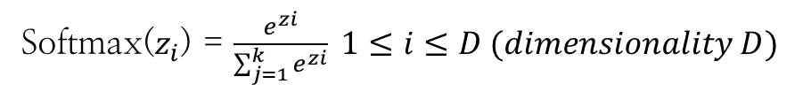
Feed-Forward Network
Softmax($z_{i}$) = $\frac{e^{zi}}{\sum_{j=1}^{k}{e^{zi}}} 1≤i≤D (dimensionality D)$
Input Layer X as Vector
Hidden Layer H as Vector
Output Layer Y as Vector
Weight W Input-Hidden
Weight U Hidden - Output
$$h=σ\left(Wx+b\right)$$
$$z=Uh$$
$$y=softmax(z)$$

Slide 12
4. Training Neural Nets

Slide 13
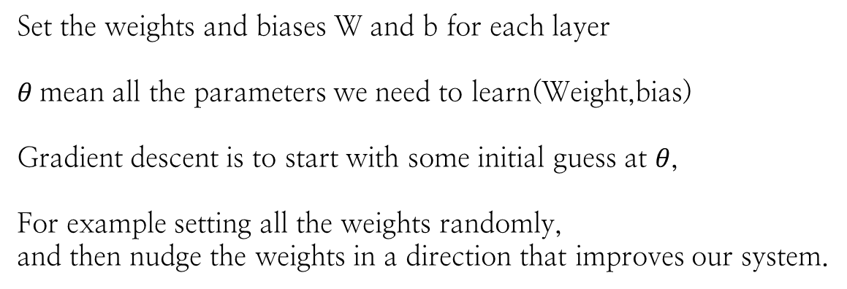
Train a neural net
Set the weights and biases W and b for each layer
$θ$mean all the parameters we need to learn(Weight,bias)
Gradient descent is to start with some initial guess at $θ$,
For example setting all the weights randomly,
and then nudge the weights in a direction that improves our system.

Slide 14


Loss function
A metric for whether the system has improved or not
Measure the distance between the system output and the gold output
This distance called loss or cost function
Find a way to minimize this loss
$$L\left(\hat{y},y\right)=How much \hat{y} differs from the true y$$
More detail
$$L\left(f(x;θ),y\right)=How much f\left(x\right) differs from the true y$$
Common loss function for linear regression– mean-squared-error
$$L_{MSE}\left(\hat{y},y\right)=\frac{1}{n}\sum_{i=1}^{m}{{({\hat{y}}^{(m)}−y^{\left(i\right)})}^{2}}$$
Common loss function for probabilistic classifier – cross entropy loss
$$L\left(\hat{y},y\right)=−\log{p({\hat{y}}_{i})}$$

Slide 15
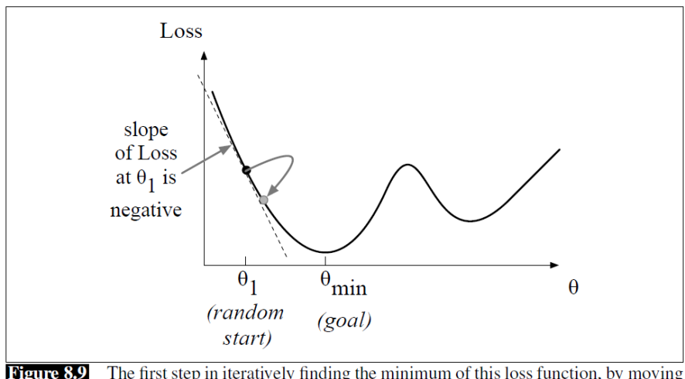
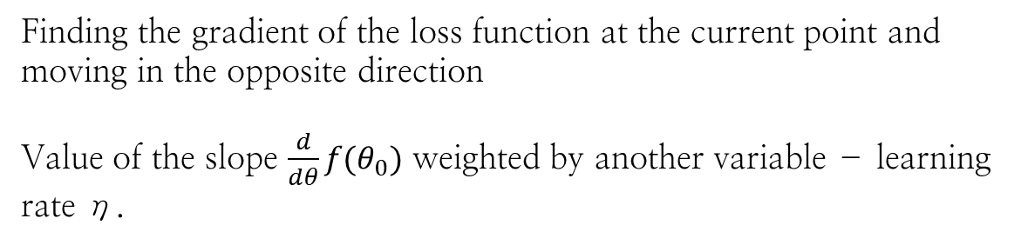
Following Gradients
Finds a minimum of a function by figuring out in which direction the functions’s slope is rising the most steeply, and moving in the opposite direction.
Finding the gradient of the loss function at the current point and moving in the opposite direction
Value of the slope $\frac{d}{dθ}f(θ_{0})$ weighted by another variable – learning rate η.

Slide 16
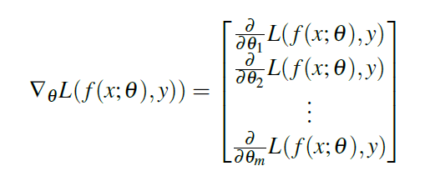

Many variables gradient
Want to know where in the N-dimensional space we should move.
Express the directional components of the sharpest slope along each of those N dimensions.

Slide 17
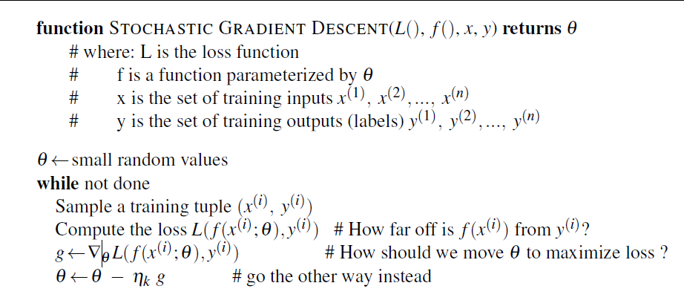
Stochastic Gradient Descent
Online algorithm that computes this gradient after each training example, and nudges θin the right direction.
can result in very choppy movements
So alternative version minibatch gradient descent
Computes the gradient over batches of training instances

Slide 18
5. Neural Language Models

Slide 19

NNLM vs N-grams
NLM don’t need smoothing
Can handle much longer histories
Can generalize over contexts of similar words
Underlie many of the models generation,machine translation and dialog
Cost for this improved performance
-strikingly slower to train
Input at time t a representation of some number of previous words
And outputs a probability distribution over possible next words
$$P\left(w_{t} | w_{1}^{t−1}\right)≈P(w_{t}|w_{t−N+1}^{t−1})$$

Slide 20

Embeddings
Each word is represented as a vector of real numbers of dimension d
Distributed representation allows words that have similar meanings, or similar grammatical properties, to have similar vectors
$$I have to make sure when I get home to feed the cat.$$
$$I forgot when I got home to feed the ______“$$
A traditional N-gram model will predict “cat”
But never seen the “feed the dog” traditional LM won’t expect “dog”
By representing words as vectors, and assuming the vector for “cat” is similar to the vector for “dog”, a neural LM, even if it’s never seen “feed the dog”

Slide 21
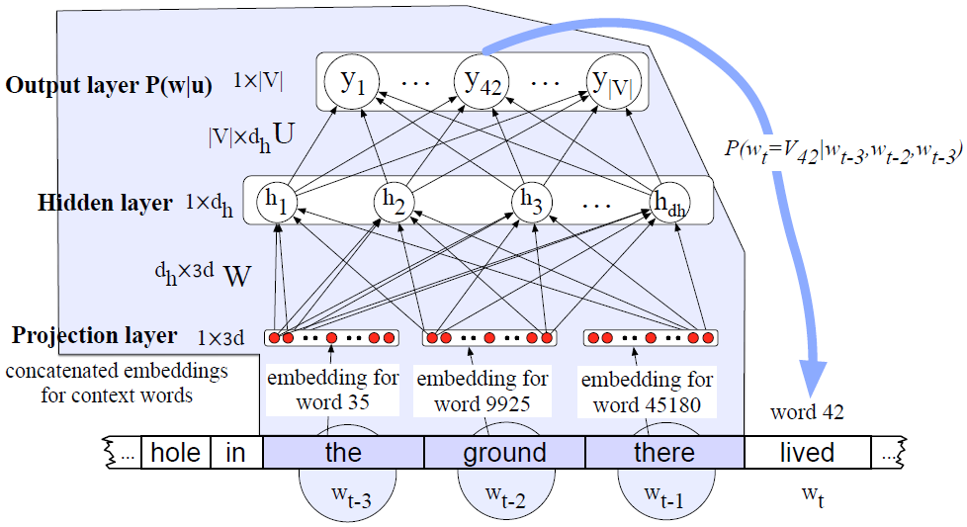
Embeddings
Input using one-hot vector

Slide 22

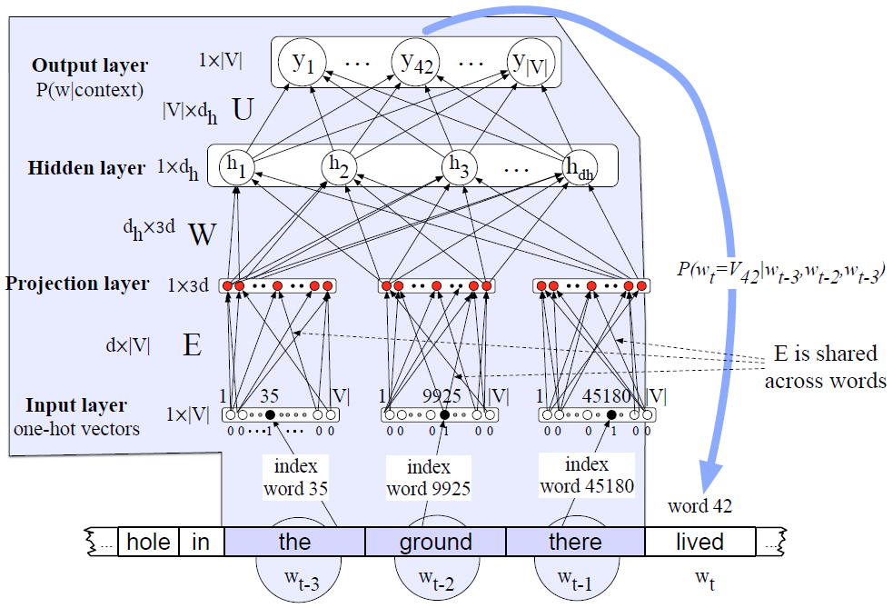
Embeddings

Slide 23

감사합니다.
이 문서는 나눔글꼴로 작성되었습니다. 설치하기

